Slide 1
Non-regular Language

Slide 2
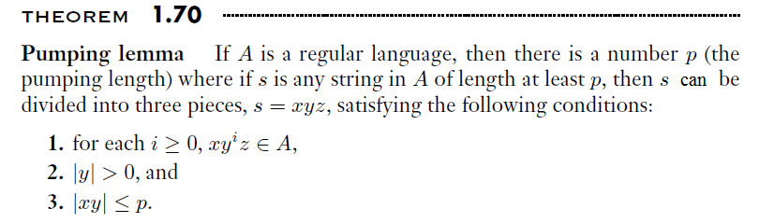

Slide 3
Some important Points
Every regular language satisfies the pumping lemma property.
If a language “L” does not satisfy the pumping lemma property, then L is non-regular.
Pumping lemma is used to prove that a language L is not regular (non-regular).
If a Language L satisfies the pumping lemma property, L need not be regular.
It can not be used to prove that a language is Regular.
Pumping lemma is used to prove that some of the languages are not regular.

Slide 4
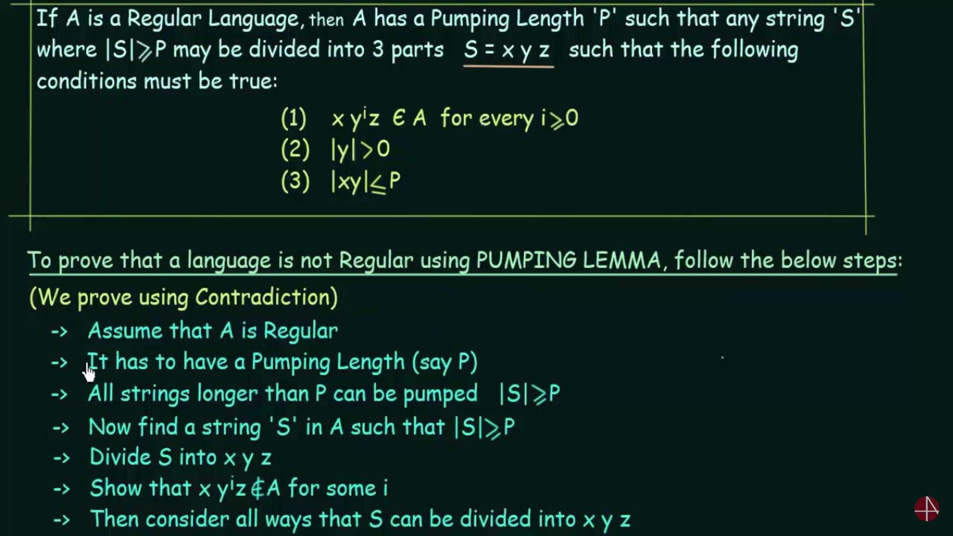

Slide 5
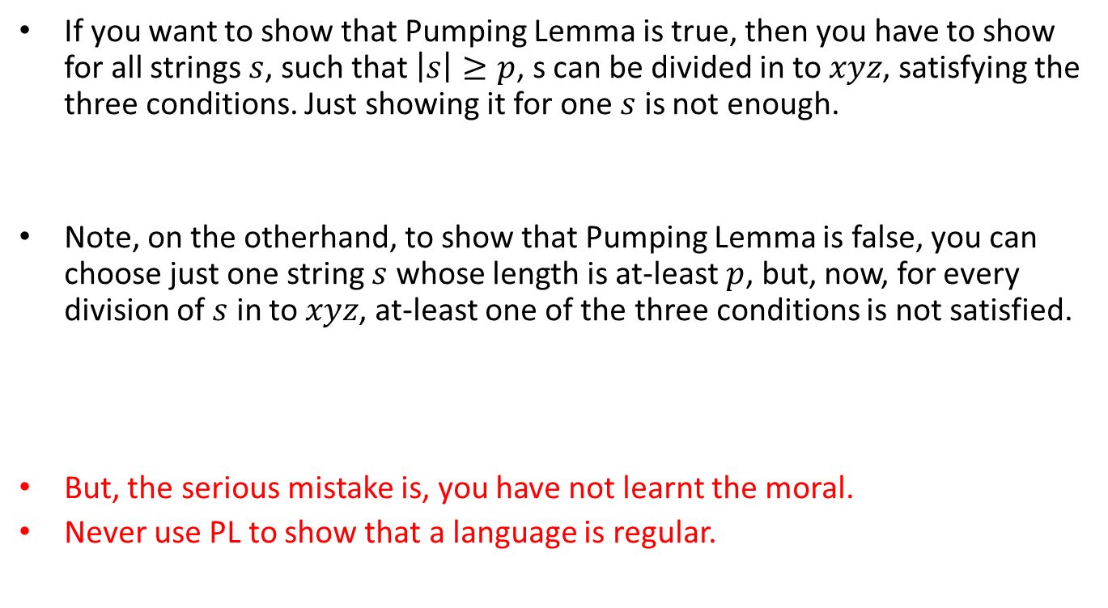
Mistakes.
If you want to show that Pumping Lemma is true, then you have to show for all strings $s$, such that $\left|s\right|≥p$, s can be divided in to $xyz$, satisfying the three conditions. Just showing it for one $s$ is not enough.
Note, on the otherhand, to show that Pumping Lemma is false, you can choose just one string $s$ whose length is at-least $p$, but, now, for every division of $s$ in to $xyz$, at-least one of the three conditions is not satisfied.
But, the serious mistake is, you have not learnt the moral.
Never use PL to show that a language is regular.

Slide 6
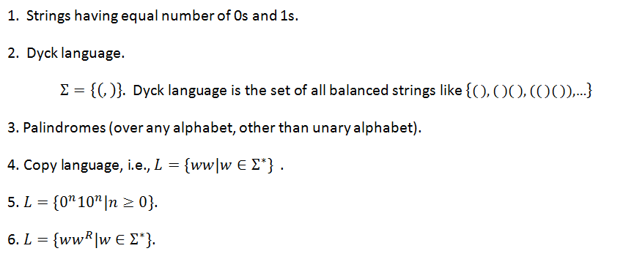
Following are all nonregular.
Can you prove for each of these that PL fails.

Slide 7

Set of primes – a nonregular language
Let $p$ be the pumping length.
Consider $s=0^{n}$ where $n$ is prime and let $n≥p$, represents a prime number.

Slide 8
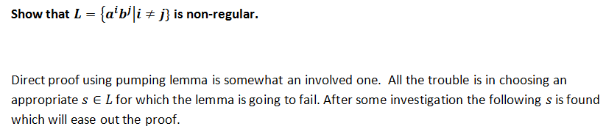
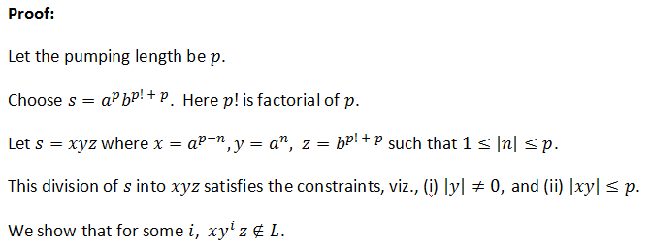

Slide 9

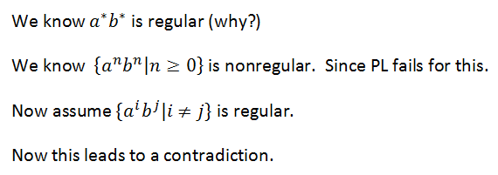
An easy way to show is nonregular

Slide 10
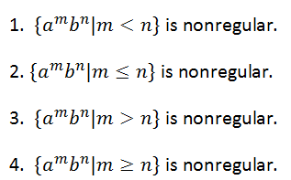
Can you prove these
(Observe the relation between m and n exists)

Slide 11
Prove or disprove: “every finite language is regular”.
Prove or disprove: “every infinite language is nonregular”.

Slide 12
Prove or disprove: “every finite language is regular”.
True. We can build a NFA.
Prove or disprove: “every infinite language is nonregular”.
False. Counter example is: a*b*

Slide 13
Prove or disprove : “nonregular languages are closed under union”.
False.
Counter example:

Slide 14
Prove or disprove : “nonregular languages are closed under intersection”.

Slide 15
Prove or disprove : “nonregular languages are closed under intersection”.
False.
Counter example:

Slide 16
Prove or disprove : “nonregular languages are closed under complementation”.

Slide 17
Prove or disprove : “nonregular languages are closed under complementation”.
True.
Proof: [by contradiction] using the fact that regular languages are closed under complementation.

Slide 18
An Important Other way of showing that a language is nonregular
By using Myhill-Nerode Theorem
DFA or NFA for a regular language must have finite number of states.
If you show that infinite number of states are needed, then it is equivalent to showing that the language in nonregular.
Apart from this, Myhill-Nerode theorem has one important application, viz., minimization of a DFA.

Slide 19
Myhill-Nerode Theorem is much more than the Pumping Lemma
Myhill-Nerode theorem can be used to show that a language is regular also. Of course it can be used to show that a language is nonregular.
This gives a necessary and sufficient condition for a language being regular.
Note, the pumping lemma, on the otherhand can be used only to show that a language is nonregular.
Pumping lemma should not be used to show that a language is regular.

Slide 20
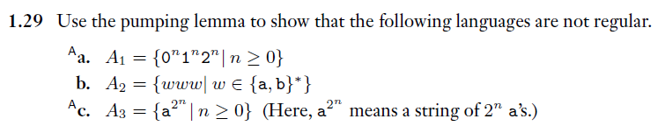
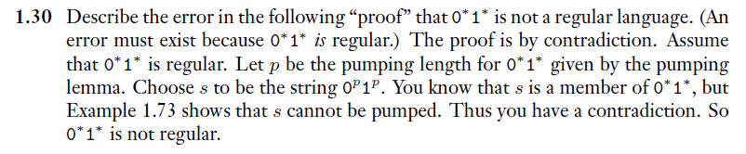
Reading Assignment – From Sipser’s book

Slide 21
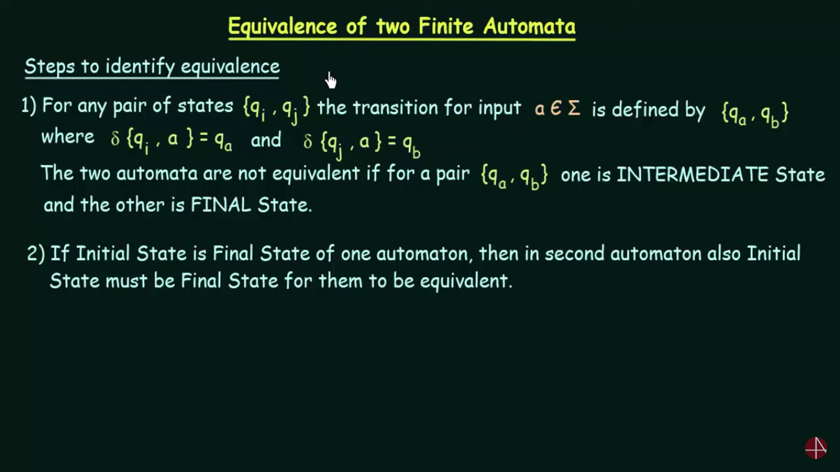
Some problems on Regular expressions

Slide 22
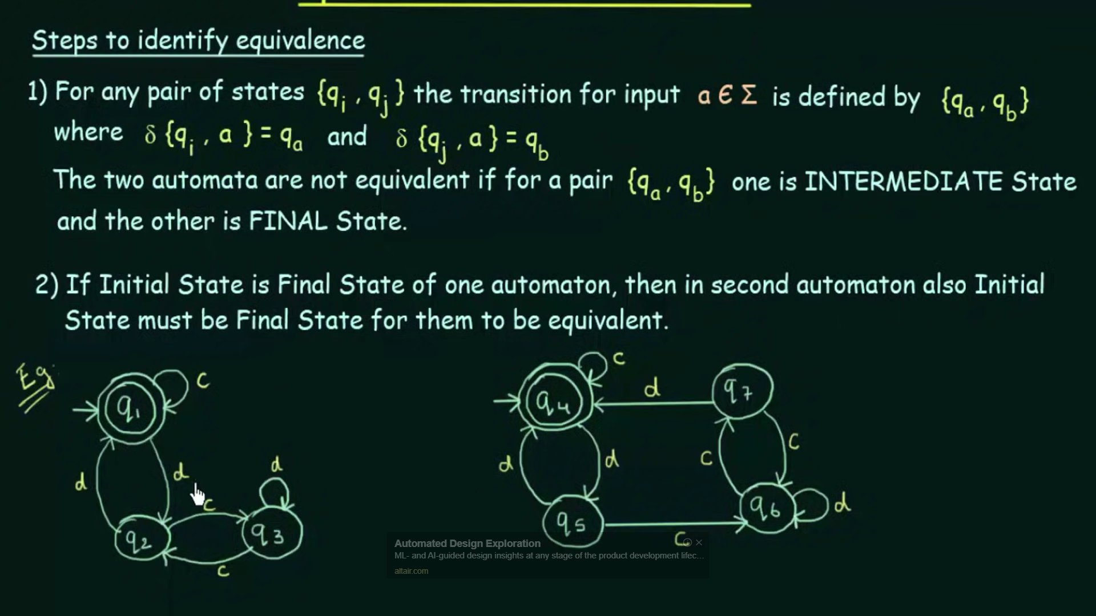

Slide 23
